Slide 1
Facilitating Community-
Informed Opioid Prescription Guidelines
Charet Bolton, Joey Zhou, Manzoor Mirza, Raja Safiullah, Yixi Qiu

Slide 2
AGENDA
Policy Question and Motivation
Data Description
Analysis
GMM
PCA - dimensionality reduction
LDA
Policy Implications

Slide 3

Policy Question & Motivation

Slide 4
Policy Question
What is the general sentiment towards the guidelines?
What concerns do people have regarding the drafted Clinical Practice Guidelines?

Slide 5
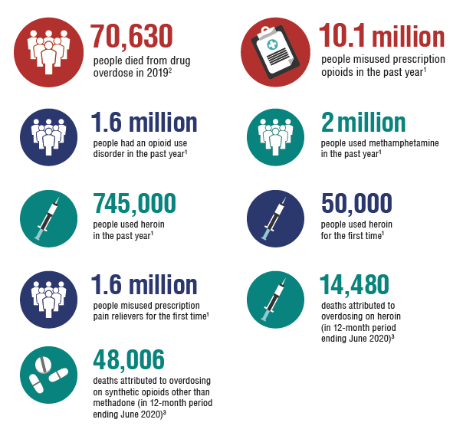
Background & Motivation
Opioid epidemic
CDC Clinical Practice Guideline for Prescribing Opioids
2022 draft of the guideline
Public Comments on the draft accepted from 2/3/2022 to 4/11/2022
Source: https://www.hhs.gov/opiods/index.html

Slide 6
Data Description
Data Source
Extracted from the Regulations.gov API using Python code, and we finally got 4,502 comments from different stakeholders.
Includes: (1)unique identification of comments, (2) number of duplicates for comments, (3) the text of the comment.
Unstructured Part
The text of comments is the unstructured part we used to answer the policy questions.
We conducted (1) lemmanization, (2) lowercase transformation, (3) stopwords filtering on the unstructured comments.
End up with 27607 lemmas

Slide 7
TF-IDF Representation
4502 Comments
1602 Words (features)
 | Words (Features)
Comments
Notes:
we used these 1602 words to fit our model

Slide 8
Question 1: Sentiment Analysis

Slide 9
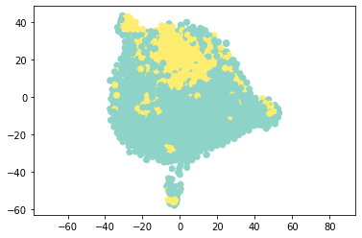
Gaussian Mixture Model Clustering - visualization with TSNE
Assuming Gaussian distribution for the data, we tune the hyperparameter K
We get K = 2, using the Calinski Harabasz (CH) Index
Visualize it using TSNE

Slide 10
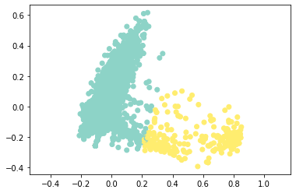
K-Means Clustering - visualization using PCA
Perform K means clustering at high dimensionality to minimize loss of information
Chose K = 2 for clustering, which worked well - forming the clusters as anticipated
Visualize it using PCA

Slide 11
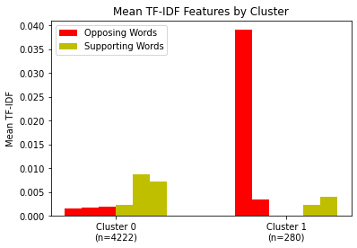
Characterization of Clusters
Characterizing clusters based on opposition and support
Opposing words: 'illegal', 'criminal', 'rescind'
Supporting words: 'control', 'concerned', 'supporting'

Slide 12
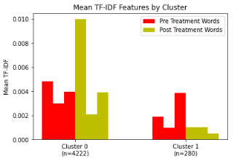
Characterization of Clusters - continued
Characterizing clusters based on aspects of CDC used for designing guidelines
Pre-treatment words: 'start', 'visit', 'short'
Post-treatment words: 'follow', 'potential', 'harm'
Notes:
Updated this chart, but our analysis and policy implications remain the same

Slide 13
Question 2: Concern Identification

Slide 14
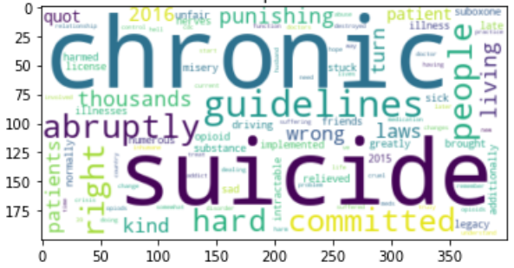
Latent Dirichlet Allocation
Notes:
This is a wordcloud we got from exploring different topics. This was from 8 topics at random state 0. intense negativity and backlash from 2016 guidelines; emphasizes importance of new guidelines

Slide 15
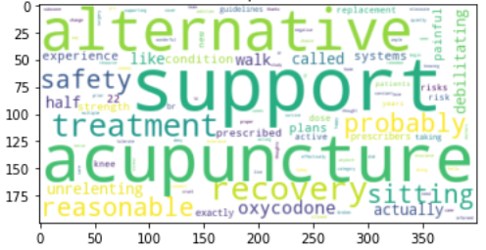
Latent Dirichlet Allocation
Notes:
This is a wordcloud we got from exploring different topics. This was from 8 topics at random state 0. Alternative, support, safety: a concern can be the effectiveness of alternative treatments in supporting the patient

Slide 16
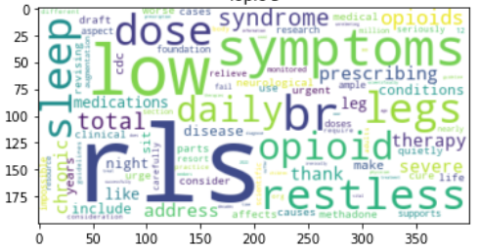
Latent Dirichlet Allocation
Notes:
This was using 4 topics (our optimal level that we used in our report bc it had the 2nd highest avg coherence and highest avg num unique words); RLS and how opioids help where conventional treatments may not, so making sure the guidelines are both broad and individualized enough for those with more rare conditions

Slide 17
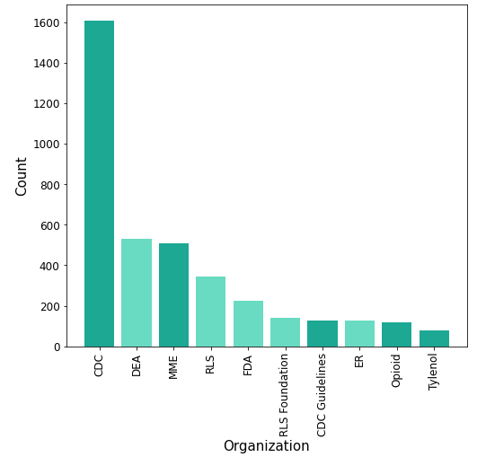
Top Entities with ORG label
Notes:
Predict concerns: stakeholder analysis; involved in implementation of guidelines and can be important to consult for the review

Slide 18
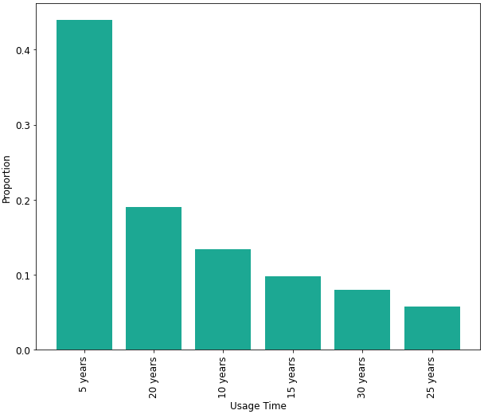
Opioid Medication Usage Distribution
Notes:
A lot of people say for 5 years but about 35% for more than 20 years; dive into concerns of chronic users to make sure they’re properly addressed within the guidelines

Slide 19
Conclusion

Slide 20
POLICY IMPLICATIONS
STAKEHOLDERS
SENTIMENTS
CONCERNS
Two distinct clusters and key agency identification
Majority supports the new guidelines
Restless Leg Syndrome, alternatives, chronic use
Notes:
Two clusters in our audience
Majority supports the new guidelines so we can continue with them for the most part, for future editions
concerns identified through topic modeling can help decisionmakers make sure the 2022 guidelines address the mentioned concerns
These insights facilitate community-informed guidelines to improve treatment and provide better care

Slide 21
THANK YOU!

Slide 22
Appendix, if questions

Slide 23
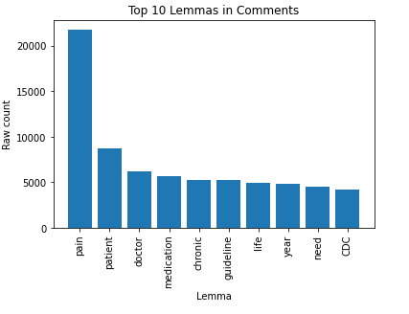
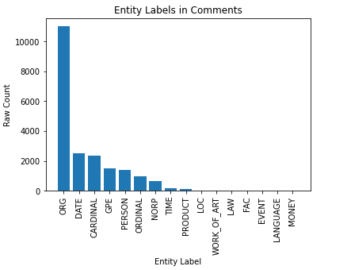
Top 10 Lemmas & Entities in Comments
Notes:
it's mostly because “cdc” belongs to ORG
another interesting thing is that virginia show up in the top words of GPE, which may suggest virginia’s

Slide 24
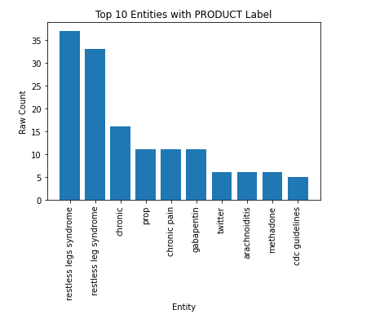
Top 10 Entities within Product Label

Slide 25
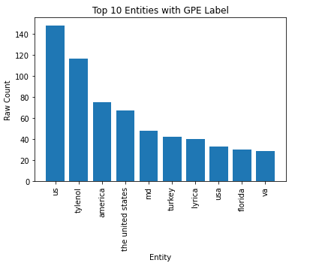
Top 10 Entities within GPE Label

Slide 26
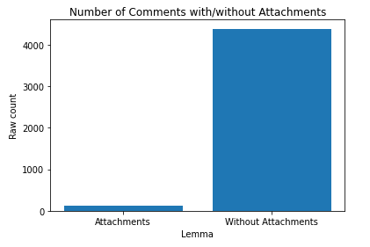
Comments with/without attachments

Slide 27
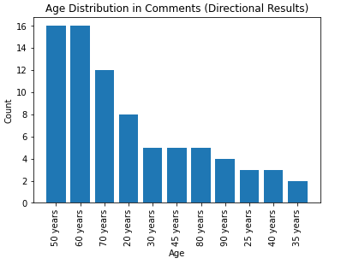
Age Distribution

Slide 28
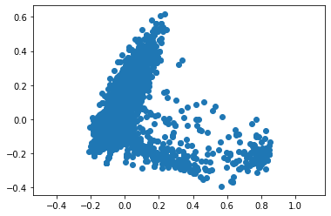
Principal Component Analysis
The PCA plot seems to do a decent job of identifying potential clusters
We can hypothesize that two clusters can be formed, with overlap

Slide 29
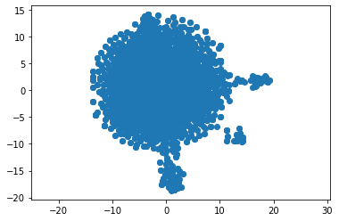
T-distributed Stochastic Neighbour Embedding
TSNE does not appear to do a better job of identifying potential clusters
At Perplexity = 30 and Learning Rate = 300, we find our best results

Slide 30
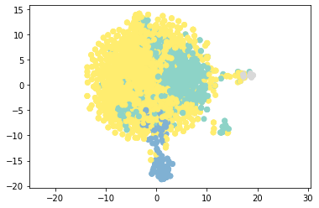
K-Means Clustering - visualizing using TSNE
Perform K means clustering at high dimensionality to minimize loss of information
Chose K = 4 for clustering, which does not appear to work well
TSNE for dimensionality reduction

Slide 31
¡MUCHAS GRACIAS!
¿Alguna pregunta?
tuemail@freepik.com
+34 620 421 838
yourcompany.com
Por favor conserva esta diapositiva para atribuirnos
Notes:
Must leave in

Slide 32
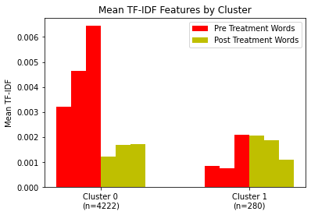
Characterization of Clusters - continued
Characterizing clusters based on aspects of CDC used for designing guidelines
Pre-treatment words: 'start', 'visit', 'dose'
Post-treatment words: 'follow', 'potential', 'harms'
Notes:
Former slide

